Slide 1
Part II - Prosper Loan
by Kristina

Slide 2
Investigation Overview
The Prosper Loan Dataset contains information on thousands of loans issued by Prosper, a peer-to-peer lending marketplace that connects borrowers with investors.
Our goal is to identify key factors that contribute to loan success or failure and to develop a predictive model that can be used to estimate the likelihood of loan default or other negative outcomes. By analyzing the Prosper loan dataset, we can gain valuable insights into the dynamics of peer-to-peer lending and develop strategies for improving loan performance and minimizing risk.

Slide 3
The aim
examine the features of loans that could serve as predictors for the borrower APR.

Slide 4
Dataset Overview
Dataset contains the informational variables such as the initial loan amount, the borrower's Prosper rating, credit grade, the loan duration, the borrower's monthly income as stated by them, their employment status, the term of the loan, their occupation and how it spread among different states.
Resulting dataFrame consists of 113066 row and 25 columns

Slide 5
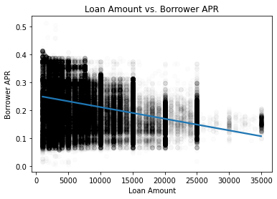
The dependence distribution between "Borrower APR" and "Loan Amount" in the Prosper loan dataset
Analysis of Prosper Loan Dataset reveals negative correlation between LoanOriginalAmount and BorrowerAPR.
Smaller loans have higher interest rates due to fixed costs associated with loan processing and origination.

Slide 6
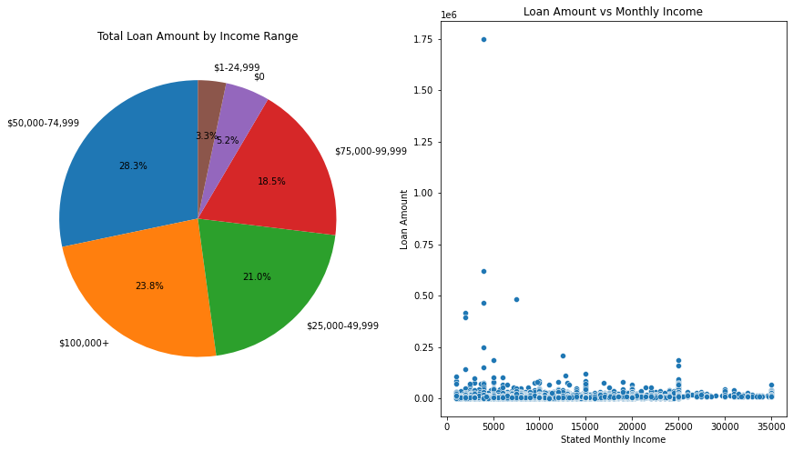
What is the average loan amount for each income range?
The income range from 50K to 75K stands out as the leader in terms of loan amount.
Small differences in loan amounts were observed between three other income ranges.
The lowest proportion of loan amounts are associated with the income range of 0 and 1-25K.

Slide 7
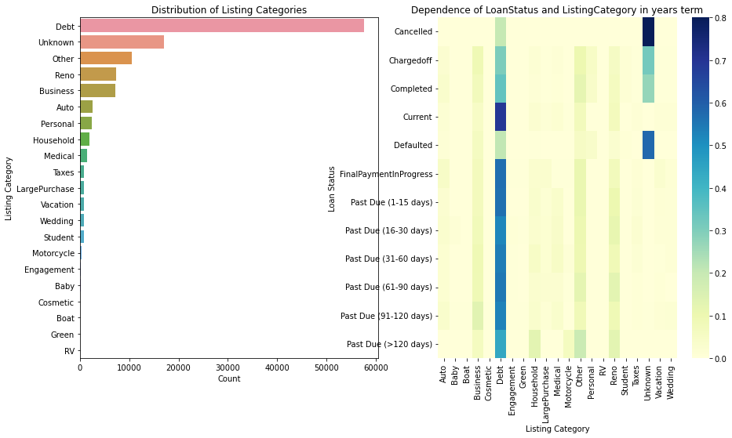
What is the most common 'LoanStatus' and 'ListingCategory'
Debt Consolidation is the most frequent listing category, with a loan amount of approximately 60000
RV is the least common listing category
Debt Consolidation had a higher proportion of loans across all years, with current loan status being the most common and defaulted status being the least frequent
Cancelled status in the Unknown category was the most frequently visualized, and loan statuses with past due from 15 days were less distributed
Student, Baby, Boat, and RV categories did not experience significant shifts in the distribution of loan statuses over the years

Slide 8
Analysis conclusions
California has the highest loan amount, followed by Texas and New York, while North Dakota has the lowest loan amount.
Borrower APR has a multimodal distribution, indicating that several factors affect APR, with a sharp peak around 0.35 indicating a threshold effect for certain borrower characteristics.
Higher ratings result in higher loan amounts across all three terms, and lenders prefer to lend to borrowers with better creditworthiness. HR proper rating only has 36-month terms, while others have all three terms.
Shorter loan terms may result in lower monthly payments but require more payments overall, and lenders may offer longer terms to borrowers with better creditworthiness.
'Debt Consolidation' had a higher proportion of loans across all years, with current loan status being the most common and defaulted status being the least frequent.
The income range from 50K to 75K is the leader in loan amounts, indicating that income range is a significant factor in determining loan amounts.
Different loan statuses have different distributions of loan amounts. 'Cancelled' status indicates a decrease in the range of loan amounts, while 'current' status displays an unsymmetrical structure with three peaks at 5000, 10000, and 15000. These insights could be used by lenders to develop more targeted lending policies based on loan status.

